Slide 1

Teaching Computers to See
Practical Workshop: From Raw Pixels to Artificial Intelligence

Slide 2
How does a computer actually "see"?
Take a guess. What is the camera really looking at?

Slide 3


The Digital Reality: Pixels
It's Just a Spreadsheet
Computers don't see colors or shapes. They read a matrix of numbers. Each pixel is represented by three values: Red, Green, and Blue (RGB), ranging from 0 to 255.

Slide 4






The Developer Toolkit
OpenCV
MediaPipe
The Magic
The "Eyes" of our computer. A massive library that handles image processing, hardware access, and basic computer vision.
The "Brain." Google's framework for high-performance machine learning, used for tracking hands, faces, and bodies.
Today we combine these tools to recreate the logic behind facial recognition and gesture control.

Slide 5
Project 01
The Digital Eye Setup
Accessing the webcam and reading the first raw matrix of numbers.

Slide 6

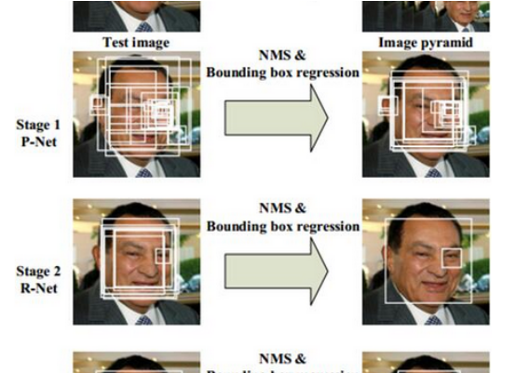
Project 02: Haar Cascades
Pattern Matching
How does it find a face without AI? It searches for Haar Features: specific contrast patterns like the bridge of the nose being brighter than the eyes.
It's not "seeing" you; it's finding dark and light rectangles that mathematically resemble a face shape.

Slide 7






The Vision Pipeline
1. Resize
2. Blur
3. Threshold
Shrinking the data. We don't need millions of pixels to find a shape; we need the core features.
Removing noise. Denoising helps the computer focus on the big shapes rather than digital static.
Binarization. Turning the world into pure Black or White to maximize mathematical contrast.

Slide 8
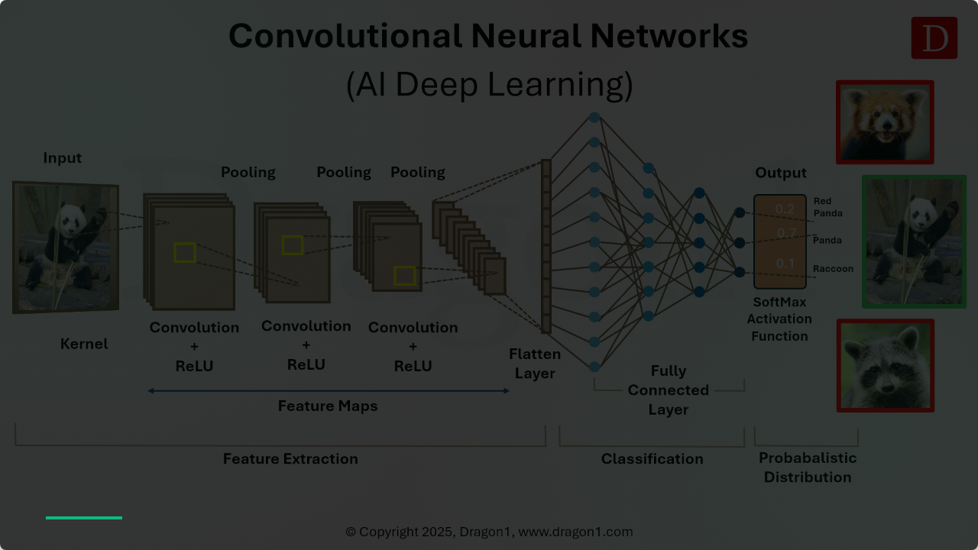

The Math: Convolution
Under the hood, a "sliding window" moves across the pixel grid, multiplying values by a filter matrix to extract features like edges and curves.
This is the foundation of the neural network's intelligence.

Slide 9
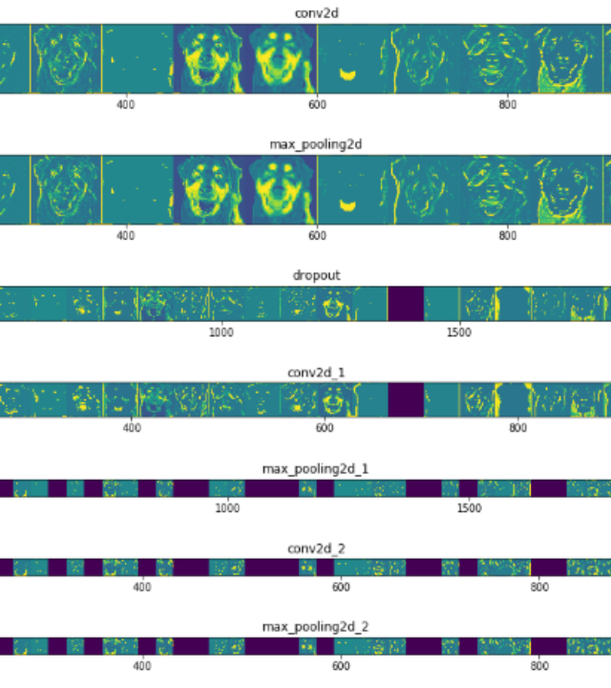
Project 03: The CNN Brain
Feature Extraction
In this demo, we peek into the neural network. Notice the Feature Maps: the computer doesn't see a '7', it sees a vertical line and a top curve.
When these specific features align in the matrix, the AI outputs a prediction with high probability.

Slide 10

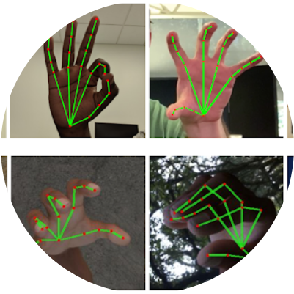
Project 04: Human Control
Tracking 21 Points
Once we know the coordinates of your hand, we can apply Euclidean Geometry. By measuring the distance between your thumb and index finger, we create a virtual volume knob.
Knowing the data means we can control the machine.

Slide 11
Project 05: Deep Interpretation
Going Beyond Shapes
70%
DeepFace moves from finding a face to interpreting a state. By analyzing 68 facial landmarks, the AI predicts gender, age, and emotional response in real-time.
This is the current peak of real-time computer vision interpretation.
Emotion Detection

Slide 12
Keep Learning
The pipeline is only the beginning. Dive deeper into the math of CNNs:
Essential Resources:
Intro to CNNs
But what is a Convolution?
Questions?

Slide 13





Image Sources
https://images.stockcake.com/public/9/a/5/9a5e330c-2c48-4bd4-9f8c-5cd0090ea9f4_large/digital-matrix-code-stockcake.jpg
Source: stockcake.com
https://miro.medium.com/1*mH7AABb6oha9g6v9jB4gjw.png
Source: medium.com
https://miro.medium.com/1*slzHFjXRkTVtFhRipPl8vw.png
Source: medium.com
https://editor.analyticsvidhya.com/uploads/51525hand_crops.png
Source: www.analyticsvidhya.com
https://www.dragon1.com/images/convolutional-neural-networks-cnns.png
Source: www.dragon1.com

